Slide 1
Interrupt Structure in 8085 Microprocessor

Slide 2
Interrupts
Interrupt is a process where an external device can get the attention of the microprocessor.
An interrupt is considered to be an emergency signal that may be serviced.
The Microprocessor may respond to it as soon as possible.
Interrupts are useful when interfacing I/O devices with low data-transfer rates, like a keyboard or a mouse, in which case polling the device wastes valuable processing time

Slide 3
The peripheral interrupts the normal application execution, requesting to send or receive data.
The processor jumps to a special program called Interrupt Service Routine (ISR)to service the peripheral
After the processor services the peripheral, the execution of the interrupted program continues.

Slide 5
Key features of interrupt
Key features in the interrupt structure of any microprocessor are:
Number and types of interrupt signals available
The address of the memory where the ISR is located for a particular interrupt signal. This address is called interrupt vector address (IVA)
Masking and unmasking feature of the interrupt signals.
Priority among the interrupts
Timing of the interrupt signals
Handling and storing of information about the interrupt program (status information)

Slide 6
Classification of Interrupts
Interrupts can be classified into two types:
Maskable Interrupts (Can be delayed or Rejected)
Masking can be done by software or hardware means.
Non-Maskable Interrupts (Can not be delayed or Rejected)
Non-maskable interrupts are interrupts that are always recognized; the corresponding ISRs are executed.

Slide 7
Classification of Interrupts
Interrupts can also be classified into two types:
Vectored (the address of the service routine is hard-wired)
Vectored interrupts require the Interrupt Vector Address (IVA) to be supplied by the external device that gives the interrupt signal. This technique is vectoring, is implemented in number of ways.
Non-vectored
Non-vectored interrupts have fixed Interrupt Vector Address for ISRs of different interrupt signals.

Slide 8
Interrupts can also be classified into two types:
Software Interrupts :
Software interrupts are special instructions, after execution transfer the control to predefined ISR.
Hardware interrupts:
are signals given to the processor, for recognition as an interrupt and execution of the corresponding ISR

Slide 9
The 8085 Interrupts
When a device interrupts, it actually wants the MP to give a service which is equivalent to asking the MP to call a subroutine. This subroutine is called ISR (Interrupt Service Routine)
The ‘EI’ instruction is a one byte instruction and is used to Enable the non-maskable interrupts.
The ‘DI’ instruction is a one byte instruction and is used to Disable the non-maskable interrupts.
The 8085 has a single Non-Maskable interrupt.
The non-maskable interrupt is not affected by the value of the Interrupt Enable flip flop.

Slide 10
Interrupt Handling Procedure
Save the PC content and information about current state (flags, registers etc) in the stack.
Load PC with the beginning address of an ISR and start to execute it.
Finish ISR when the return instruction is executed.
Return to the point in the interrupted program where execution was interrupted.

Slide 11
Interrupt Sources and Vector Addresses in 8085
Software Interrupts:
8085 instruction set includes eight software interrupt instructions called Restart (RST) instructions.
These are one byte instructions that make the processor execute a subroutine at predefined locations.

Slide 12
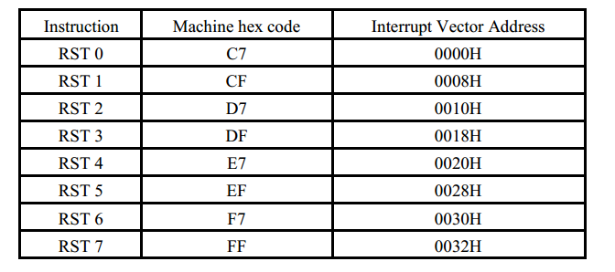
Software interrupts and their vector addresses

Slide 13
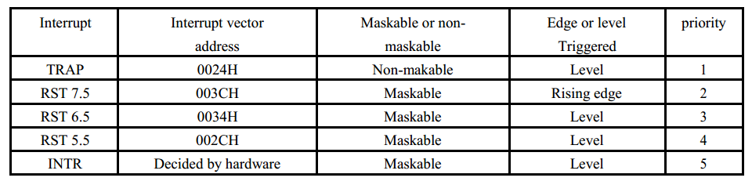
Hardware Interrupts and Priorities
8085 have five hardware interrupts – INTR, RST 5.5, RST 6.5, RST 7.5 and TRAP.

Slide 14
Masking of Interrupts
Masking can be done for four hardware interrupts INTR, RST 5.5, RST 6.5, and RST 7.5.

Slide 15
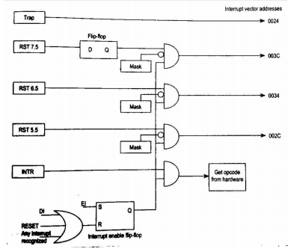

Slide 16
Masking of Interrupts
The maskable interrupts are by default masked by the Reset signal.
The interrupts can be enabled by the EI instruction.
The three RST interrupts can be selectively masked by loading the appropriate word in the accumulator and executing SIM instruction. This is called software masking.
All maskable interrupts are disabled whenever an interrupt is recognized.
All maskable interrupts can be disabled by executing the DI instruction.

Slide 17
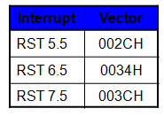
The 8085 Maskable/Vectored Interrupts
The 8085 has 4 Masked/Vectored interrupt inputs.
RST 5.5, RST 6.5, RST 7.5
They are all maskable.
They are automatically vectored according to the following table:

Slide 18
Masking RST 5.5, RST 6.5 and RST 7.5
These three interrupts are masked at two levels:
Through the Interrupt Enable flip flop and the EI/DI instructions.
The Interrupt Enable flip flop controls the whole maskable interrupt process.
Through individual mask flip flops that control the availability of the individual interrupts.
These flip flops control the interrupts individually.

Slide 19
The 8085 Maskable/Vectored Interrupt Process
The interrupt process should be enabled using the EI instruction.
The 8085 checks for an interrupt during the execution of every instruction.
If there is an interrupt, and if the interrupt is enabled using the interrupt mask, the microprocessor will complete the executing instruction, and reset the interrupt flip flop.
The microprocessor then executes a call instruction that sends the execution to the appropriate location in the interrupt vector table.

Slide 20
Interrupt Vectors and the Vector Table
An interrupt vector is a pointer to where the ISR is stored in memory.
All interrupts (vectored or otherwise) are mapped onto a memory area called the Interrupt Vector Table (IVT).
The purpose of the IVT is to hold the vectors that redirect the microprocessor to the right place when an interrupt arrives.

Slide 21
Manipulating the Masks
The Interrupt Enable flip flop is manipulated using the EI/DI instructions.
The individual masks for RST 5.5, RST 6.5 and RST 7.5 are manipulated using the SIM instruction.
This instruction takes the bit pattern in the Accumulator and applies it to the interrupt mask enabling and disabling the specific interrupts.

Slide 22
SIM Instruction
The SIM instruction is used to mask or unmask RST hardware interrupts.
When executed, the SIM instruction reads the content of accumulator and accordingly mask or unmask the interrupts.

Slide 23
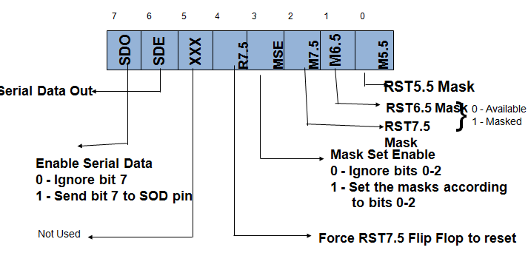
How SIM Interprets the Accumulator

Slide 24
Bit 0 is the mask for RST 5.5
Bit 1 is the mask for RST 6.5
Bit 2 is the mask for RST 7.5.
If the mask bit is 0, the interrupt is available.
If the mask bit is 1, the interrupt is masked.

Slide 25
Bit 3 (Mask Set Enable - MSE) is an enable for setting the mask.
If it is set to 0 the mask is ignored and the old settings remain.
If it is set to 1, the new setting are applied.
The SIM instruction is used for multiple purposes and not only for setting interrupt masks.
It is also used to control functionality such as Serial Data Transmission.

Slide 26
The RST 7.5 interrupt is the only 8085 interrupt that has memory.
If a signal on RST7.5 arrives while it is masked, a flip flop will remember the signal.
When RST7.5 is unmasked, the microprocessor will be interrupted even if the device has removed the interrupt signal.
This flip flop will be automatically reset when the microprocessor responds to an RST 7.5 interrupt.

Slide 27
Bit 4 of the accumulator in the SIM instruction allows explicitly resetting the RST 7.5 memory even if the microprocessor did not respond to it.
Bit 5 is not used by the SIM instruction

Slide 28
In addition to masking interrupts, SIM instruction can be used to send serial data on the SOD line of the processor.
The data to be send is placed in the MSB bit of the accumulator and the serial data output is enabled by making D6 bit to 1.

Slide 29
RIM Instruction
RIM instruction is used to read the status of the interrupt mask bits.
When RIM instruction is executed, the accumulator is loaded with the current status of the interrupt masks and the pending interrupts.

Slide 30
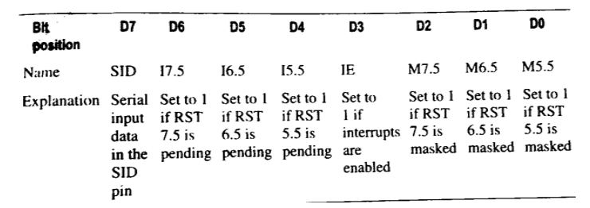
Accumulator bit pattern after execution of RIM instruction

Slide 31
Bits 0-2 show the current setting of the mask for each of RST 7.5, RST 6.5 and RST 5.5
They return the contents of the three mask flip flops.
They can be used by a program to read the mask settings in order to modify only the right mask.
Bit 3 shows whether the maskable interrupt process is enabled or not.
It returns the contents of the Interrupt Enable Flip Flop.
It can be used by a program to determine whether or not interrupts are enabled.

Slide 32
Bits 4-6 show whether or not there are pending interrupts on RST 7.5, RST 6.5, and RST 5.5
Bits 4 and 5 return the current value of the RST5.5 and RST6.5 pins.
Bit 6 returns the current value of the RST7.5 memory flip flop.
Bit 7 is used for Serial Data Input.
The RIM instruction reads the value of the SID pin on the microprocessor and returns it in this bit.

Slide 33
RIM instruction is also used to read the serial data on the SID pin of the processor.
The data on the SID pin is stored in the MSB of the accumulator after the execution of the RIM instruction.

Slide 34
Pending Interrupts
Since the 8085 has five interrupt lines, interrupts may occur during an ISR and remain pending.
Using the RIM instruction, it is possible to can read the status of the interrupt lines and find if there are any pending interrupts

Slide 35
Issues in Implementing INTR Interrupts
How long must INTR remain high?
The microprocessor checks the INTR line one clock cycle before the last T-state of each instruction.
The INTR must remain active long enough to allow for the longest instruction.
The longest instruction for the 8085 is the conditional CALL instruction which requires 18 T-states.
Therefore, the INTR must remain active for 17.5 T-states.
If f= 3MHZ then T=1/f and so, INTR must remain active for [ (1/3MHZ) * 17.5 ≈ 5.8 micro seconds].

Slide 36
The INTR line must be deactivated before the EI is executed. Otherwise, the microprocessor will be interrupted again.
Once the microprocessor starts to respond to an INTR interrupt, INTA becomes active (=0).
Therefore, INTR should be turned off as soon as the INTA signal is received.

Slide 37
Using the SIM Instruction to Modify the Interrupt Masks
Set the interrupt masks so that RST5.5 is enabled, RST6.5 is masked, and RST7.5 is enabled.
First, determine the contents of the accumulator
- Enable 5.5 bit 0 = 0
- Disable 6.5 bit 1 = 1
- Enable 7.5 bit 2 = 0
- Allow setting the masks bit 3 = 1
- Don’t reset the flip flop bit 4 = 0
- Bit 5 is not used bit 5 = 0
- Don’t use serial data bit 6 = 0
- Serial data is ignored bit 7 = 0
Contents of accumulator are: 0AH

Slide 38
EI ; Enable interrupts including INTR
MVI A, 0A ; Prepare the mask to enable RST 7.5, and 5.5, disable 6.5
SIM ; Apply the settings RST masks

